Slide 1

Project Overview: Hangman Game
The Hangman game is a timeless word-guessing challenge.
We will build a fully functional browser version with JavaScript.

Slide 2


Introduction - What is Hangman?
Classic Gameplay
Objective
Skills Engaged
Players guess a hidden word letter by letter.
Guess the word before the hangman figure is complete.
Enhances vocabulary, spelling, and logic.

Slide 3
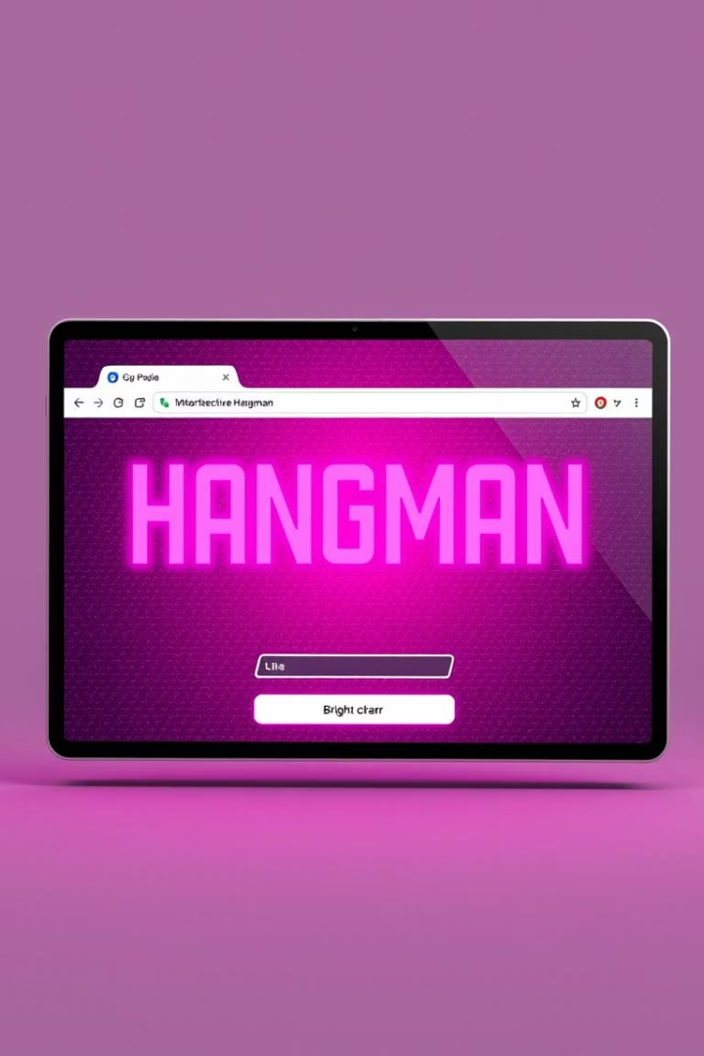
Project Goal & Objectives
User Interface
Create an intuitive, attractive game layout.
Game Logic
Implement word selection and guess validation.
Visual Feedback
Show correct letters and hangman progress.
Responsiveness
Ensure smooth play on desktop and mobile.

Slide 4
Game Features
Word Selection
Visual Feedback
Randomly chosen from a predefined word list.
Correct letters reveal in the word.
Guess Input
Wrong guesses add parts to hangman figure.
Single letter entries from the player.
Game Limits
Guess Display
Fixed number of attempts before losing.
Guessed letters shown to avoid repeats.
Game Outcome
Win or lose messages with word reveal.

Slide 5
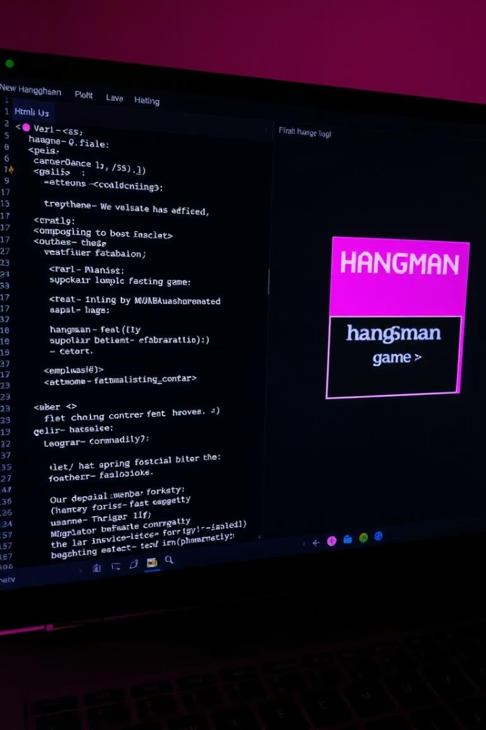



Technical Specifications
HTML5
CSS3
JavaScript
Structured game layout with semantic tags.
Responsive design and hangman drawing visuals.
Core logic, user input, and dynamic UI updates.

Slide 6






Game Mechanics
Initialization
Choose word, reset guesses and hangman state.
Player Input
Enter letter via keyboard or UI.
Validation
Ensure letter is new and valid.
Update Game
Reveal letters or add hangman parts.
Check State
Win if all letters guessed; lose if hangman complete.
Game End
Display result and offer replay option.

Slide 7
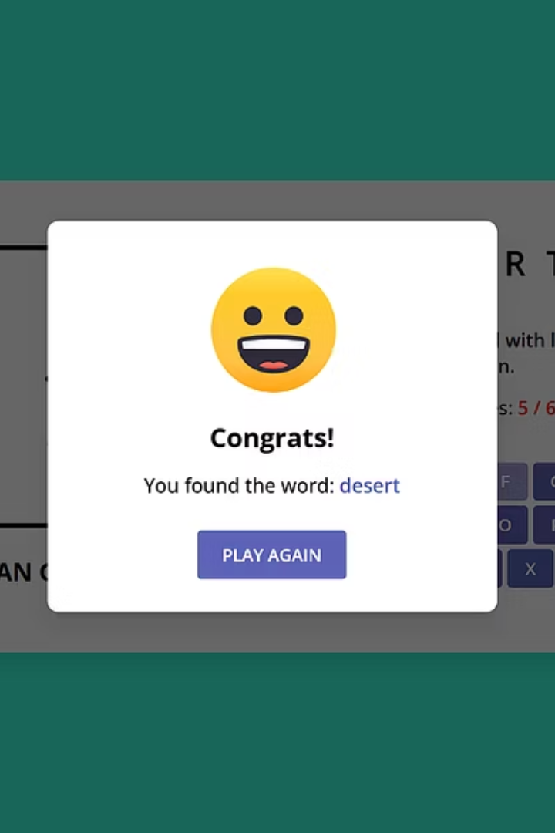
Live Demo
Let’s see the Hangman game in action now!
Open index.html in your browser to start playing.

Slide 8
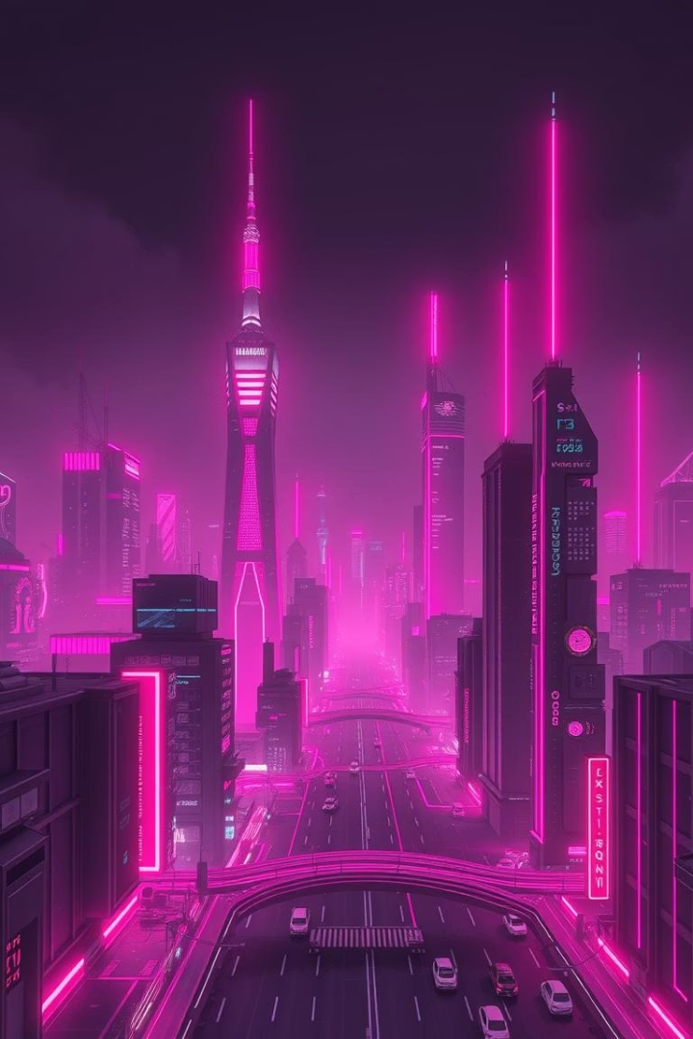
Future Enhancements
1
Word Categories
Players choose themes like animals or countries for tailored gameplay.
2
Difficulty Levels
Easy, medium, and hard modes based on word length or lives.
3
Score Tracking
Track player wins and losses for competitive play.
4
Visual Improvements
Add animations and custom fonts to enhance engagement.

Slide 9


Conclusion
Project Success
Functional and engaging Hangman game delivered.
Next Steps
Explore mobile app development and feature enhancements.

Slide 10
PROJECT TEAM
ABHISHEK MITTAL
LAKSHAY
KRISH MANGLA
PROJECT MANAGER- BACKEND (JS)
TEAM LEADER- FRONTEND
BACKEND (JS)

Slide 11
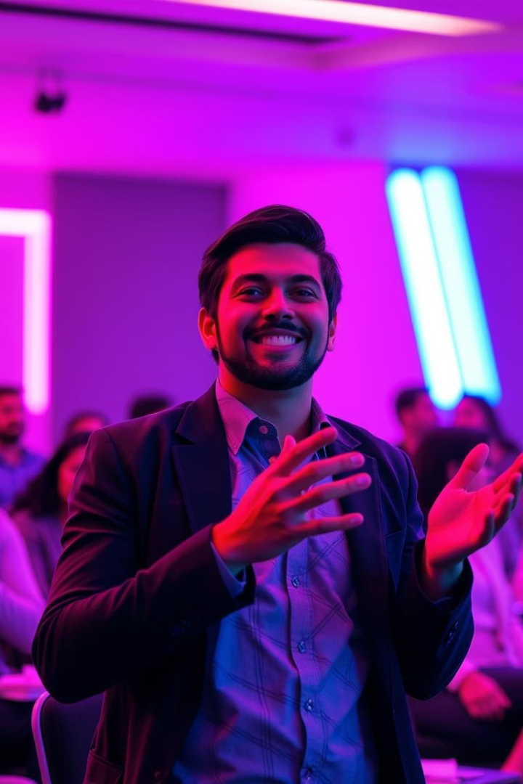
Questions & Thank You
Thank you for your time and attention!
Contact:
ABHISHEK MITTAL- Mittalabhishek703@gmail.com

